Slide 1
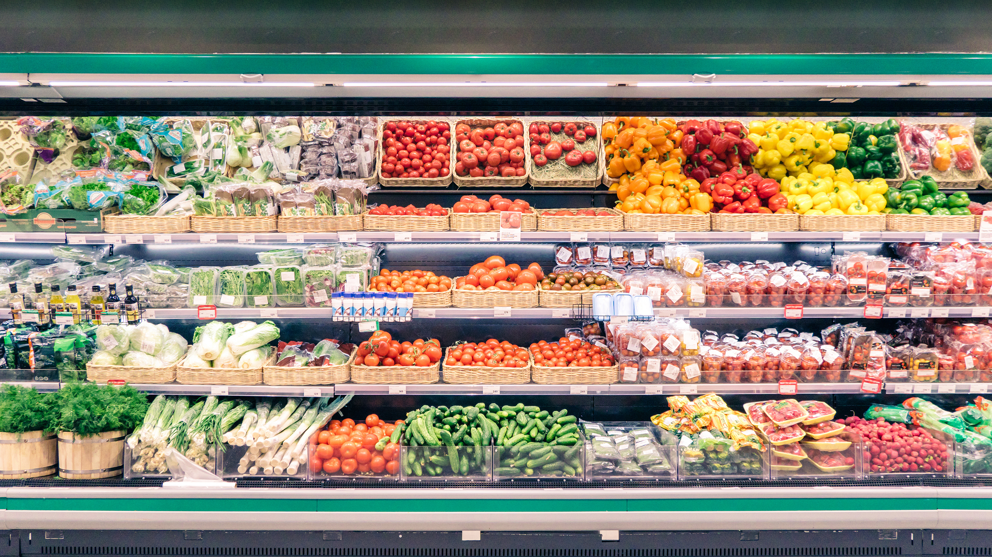
FoodCorp Store Performance Analysis
A comparative overview of Key Performance Indicators

Slide 2

Purpose of the analysis
To evaluate the performance of four different stores (Birmingham B1, London E1, London SW1X, Nottingham NG1) based on various key performance indicators (KPIs) across multiple dimensions.
The analysis aims to provide insights into determining which store needs marketing investment the most.

Slide 3
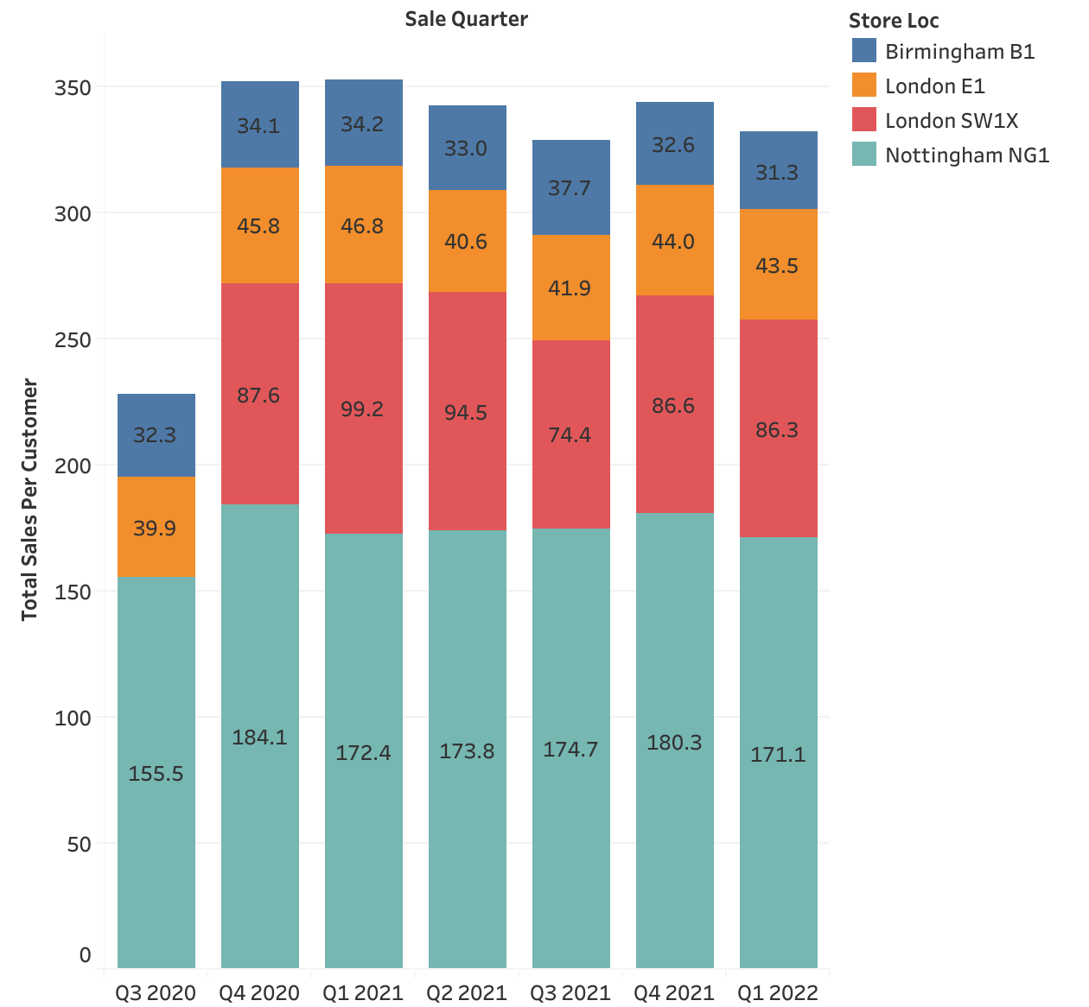
Total sales per customer
Nottingham NG1 exhibits robust sales per customer, indicating a strong local customer base
London SW1X maintains high average sales per customer, even amidst overall sales decreases, presenting a strategic investment opportunity
Other stores display varying trends, requiring tailored strategies

Slide 4
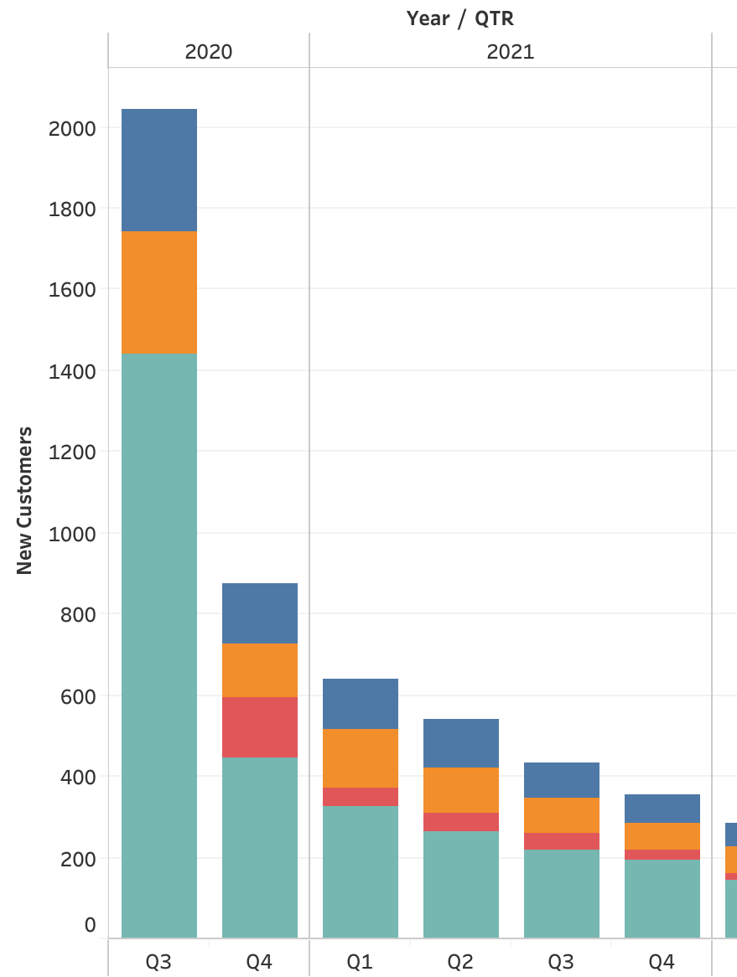
New Customer Acquisition Trend
All stores experienced a consistent decrease in new customer acquisition, signaling a broader market trend.
London SW1X exhibited a more significant decline, suggesting the need for targeted marketing efforts to attract new customers.

Slide 5
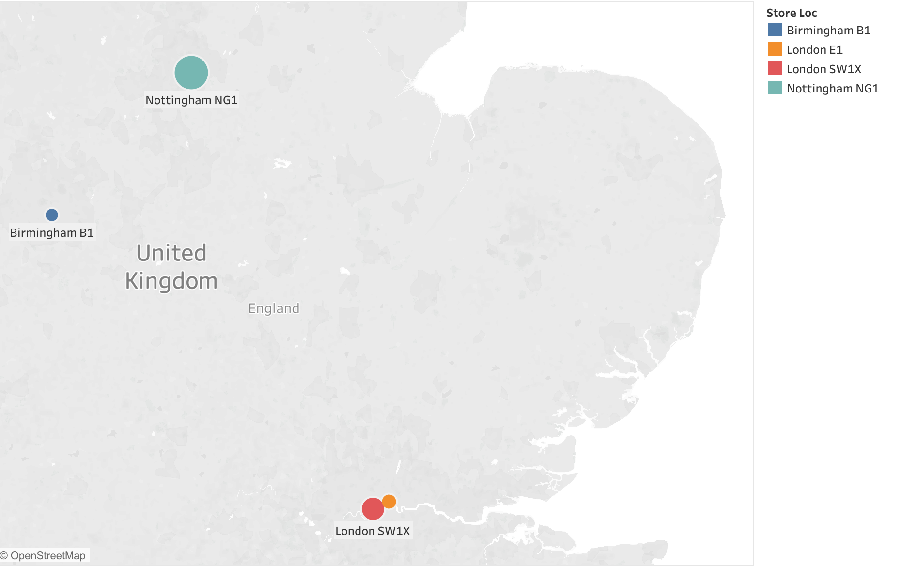
Customer Lifetime Value
Nottingham Ng1 Exceptional CLV of £612.39, highest average customer spend
Birmingham B1 & London E1 Lower CLVs of GBP 83.34 and GBP 107.84 respectively.
London SW1X Impressive CLV of £274.69, indicating robust revenue potential.

Slide 6
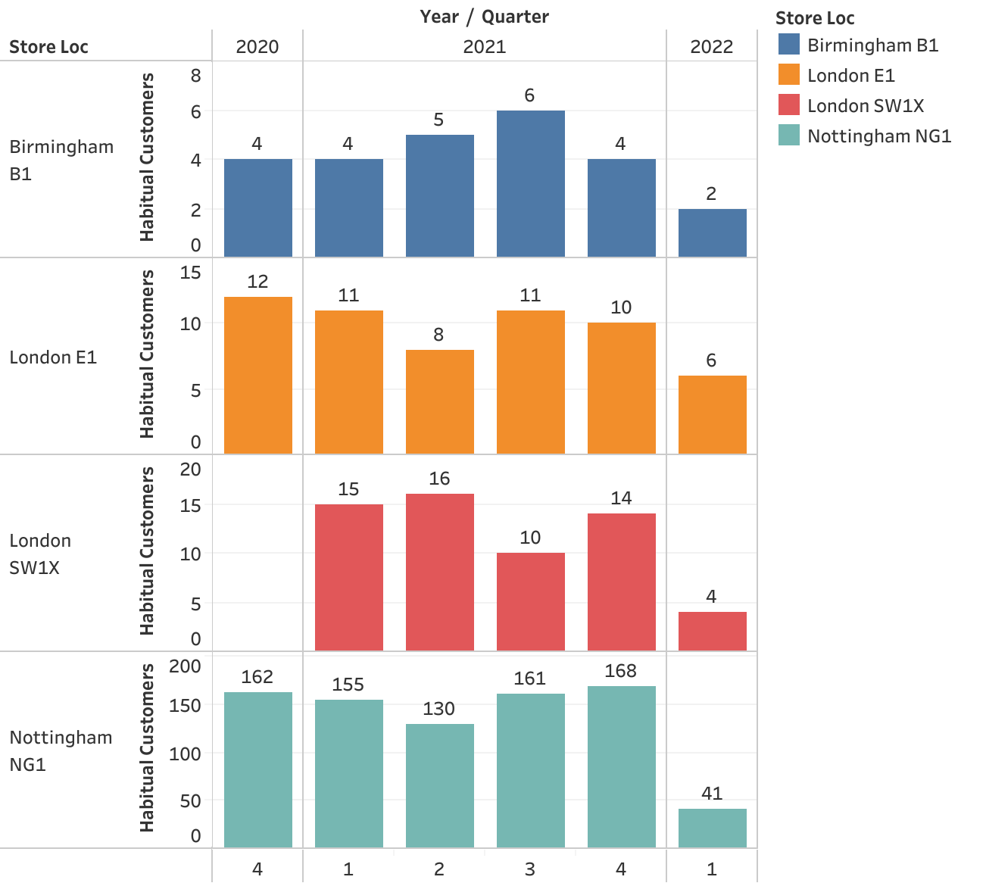
Habitual Customers
Nottingham NG1 leads with consistently high numbers of habitual customers, peaking at 168 in Q4 2021.
Despite the overall decline in habitual customers, London SW1X exhibited more consistent retention compared to stores like London E1 and Birmingham B1

Slide 7

Sales based on the day of the week
Nottingham NG1 and London SW1X show a preference for weekend shopping.
This aligns with Nottingham's successful performance, indicating potential for London SW1X to capitalize on similar customer behavior.
London E1 and Birmingham B1 stores exhibit an even distribution of sales across all days of the week, indicating no specific preference for weekend shopping among customers.

Slide 8
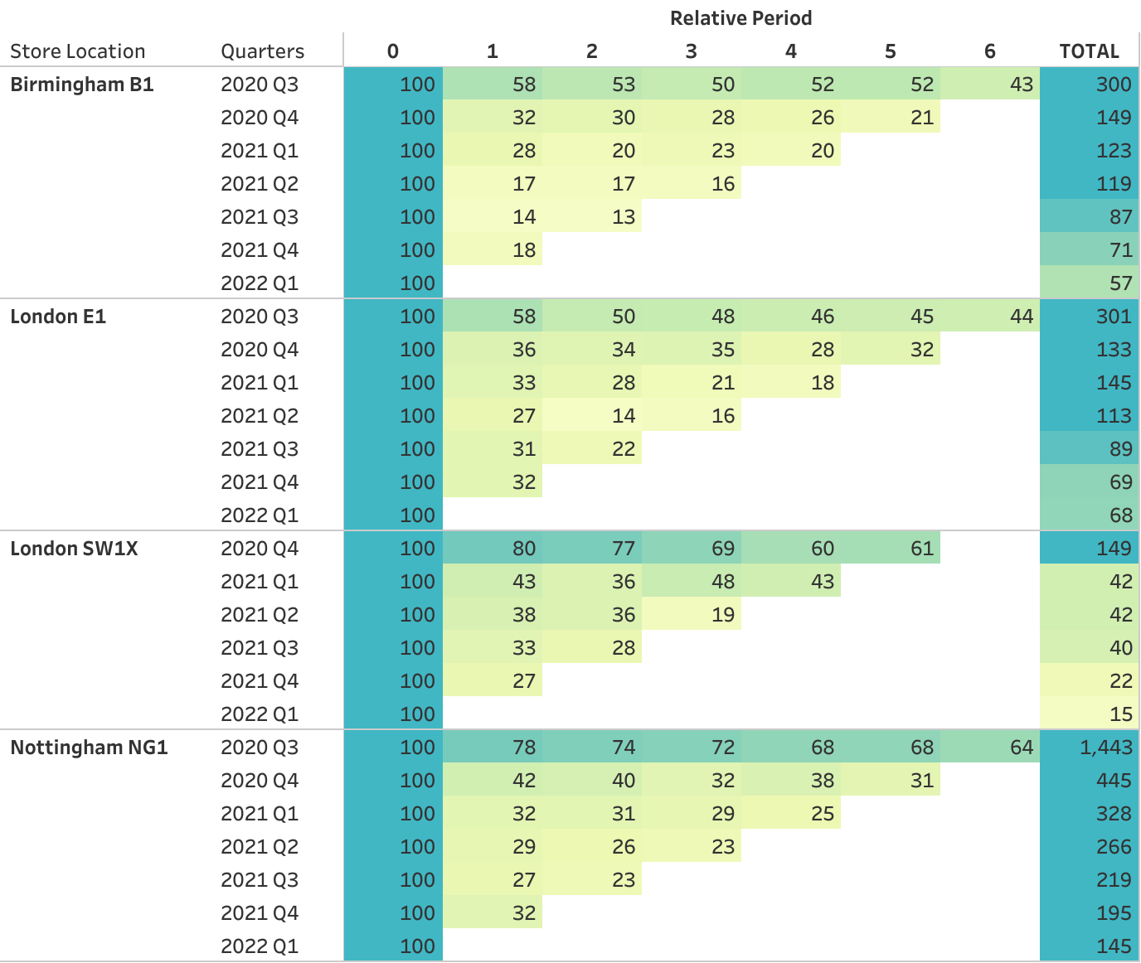
Cohort Retention Analysis
Cohort retention analysis reveals consistent performance across all stores, indicating customer retention efforts
The analysis underscores the potential of long-term customer relationships in London SW1X, suggesting a positive impact on marketing ROI.

Slide 9
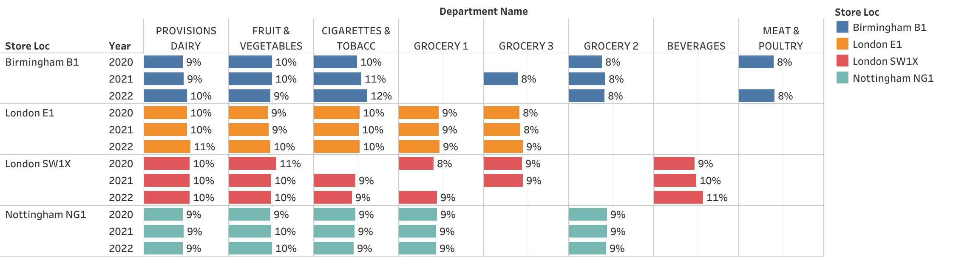
Departmental Sales Analysis
Balanced performance across key departments of Nottingham NG1, Birmingham B1 and London E1 stores
For London SW1X, notable growth in Beverages department and inconsistencies in Grocery related departments shows potential for improvement with targeted investments

Slide 10

Conclusion
The comparative analysis suggests directing marketing investments towards London SW1X for optimal returns.
The store exhibits consistent strengths, and by addressing specific challenges, it can become a flagship location for enhanced performance and profitability.
This strategic focus aligns with the overall goal of maximizing store performance and customer value.

Slide 11


